Slide 1
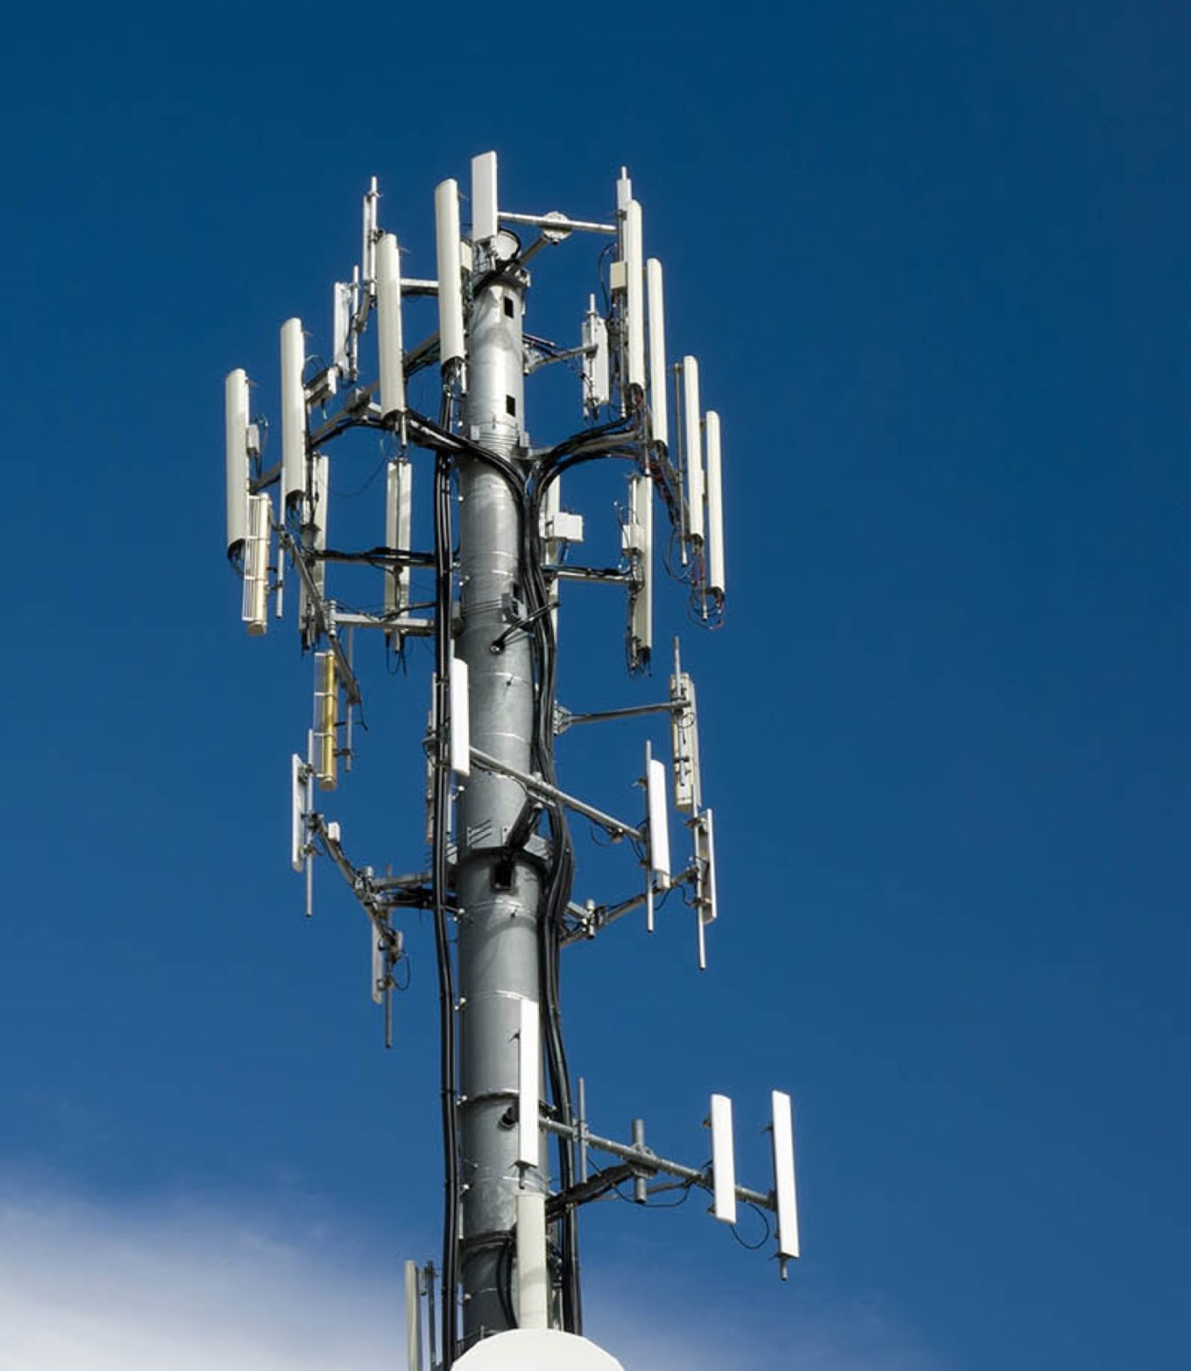
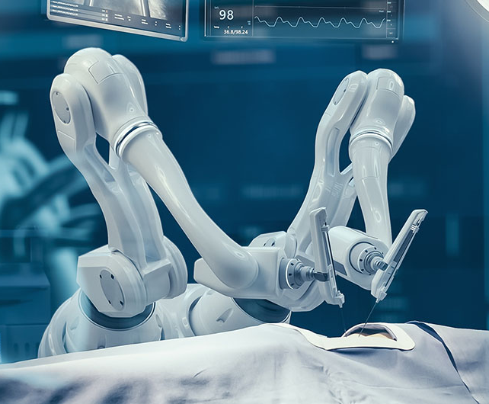




NextGen-Tech
Introducing
Remote-surgery
Hardware
Revolutionizing Surgery with 5G Technology
We Offer:
Mobile 5G Cell Towers
Real–Time 5G Connectivity
Advanced Robotic Systems
Haptic Feedback
Global Access to Expert Surgeons
Bridging the Gap Between Expertise & Patients
As 5G technology transforming remote surgery, we provide the connectivity and precision from expert to patients
Unubold.luvsandagva@student.lab.fi
+358 0413689704

